Slide 1

GLOBAL ACADEMY OF TECHNOLOGY DEPARTMENT OF COMPUTER SCIENCE AND ENGINEERING
Subject Name | Mini Project | Subject Code | 22CSEP56
Student Name | FAISAL MAKANADAR | USN | 1GA23CS400
 | RACHIT KALAL |  | 1GA23CS409
Domain | Artificial Intelligence and Multimedia Processing | Group No: | G73
Project Title | "VidSumm: AI-Powered Video and YouTube Summarizer"
Under taken at
Guide Name | Prof. Shwetha S N

Slide 2

Agenda
Introduction
Problem Statement
Literature Survey
Objectives and Scope of the Mini Project work
Proposed Solution
Requirements Specifications
Methodology/Architecture
Conclusions
Bibliography

Slide 3

Introduction
This project, VidSumm, integrates advanced AI technologies to automate the summarization of video content.
It handles both user-uploaded videos and YouTube links, offering flexibility and convenience.
AI is increasingly being used for natural language understanding and content generation.
Summarization systems are gaining traction in e-learning, media, and corporate sectors to make content more accessible.

Slide 4
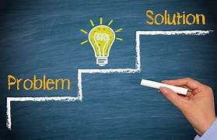
Problem Statement
Users often lack the time to watch lengthy videos or consume entire content.
Manual summarization is time-consuming and impractical for large volumes of data.
Existing tools struggle to handle both user-uploaded videos and YouTube content effectively.
Limited accessibility for users who need quick and concise insights from videos.
A need exists for an automated solution that provides accurate, efficient, and user-friendly video summarization.

Slide 5

Literature Survey
Sr. No. | Problem Statement | Paper/Source | Advantages | Disadvantage
1. | Difficulty in manually summarizing long video content. | IEEE Paper on "Video Content Summarization" | Provides automated summarization for videos. | May miss user-specific details or context.
2. | Extracting meaningful insights from audio content is time-consuming. | IEEE Paper on "Audio Summarization Techniques" | Effective for speech-to-text summarization. | Limited accuracy for noisy audio environments.
3. | Manual processing of large textual data takes significant time. | IEEE Paper on "Text Summarization Algorithms" | Reduces time for reading lengthy articles. | Summaries may lose important contextual details.

Slide 6

Objectives
To automate the transcription and summarization of videos.
To deliver accurate, concise summaries tailored to user needs.
Scope:
For students and educators, it simplifies the process of summarizing long lectures or tutorials.
For professionals, it helps summarize meetings and webinars.
For entertainment, it extracts highlights from interviews and documentaries..

Slide 7

Proposed Solution
Workflow:
Step 1: Extract audio from uploaded video or YouTube link.
Step 2: Transcribe the audio into text using Whisper.
Step 3: Summarize the transcription using HuggingFace Transformers.
Step 4: Present the summarized output to the user.
Key Features:
Supports videos in multiple formats.
Handles long videos using chunking for summarization.
User-friendly interface for seamless interaction.

Slide 8

Requirements Specifications
Hardware Requirements:
CPU with multi-core support for faster processing.
GPU for model inference acceleration (optional but recommended).
Software Requirements:
Flask: Backend framework for handling requests.
MoviePy: Library for video and audio extraction.
Whisper: Transcription model for speech-to-text conversion.
HuggingFace Transformers: Summarization pipeline.
Environment:
Python 3.8 or above.
Compatible IDE like PyCharm or VS Code.

Slide 9

Methodology
STEP | DESCRIPTION
Data input | Accepts video files or Youtube URLs from users
Audio Extraction | Extracts audio from uploaded video files using the MoviePy library.
Transcription | Converts audio to text using the Whisper Al model for accurate transcription
Text Summarization | Processes transcribed text using a Transformers-based summarization pipeline.
Summary Generatio | Generates concise summaries by splitting text into chunks and summarizing each chunk.
Output Delivery | Presents the final summary to the user in a structured format via the web interface

Slide 10

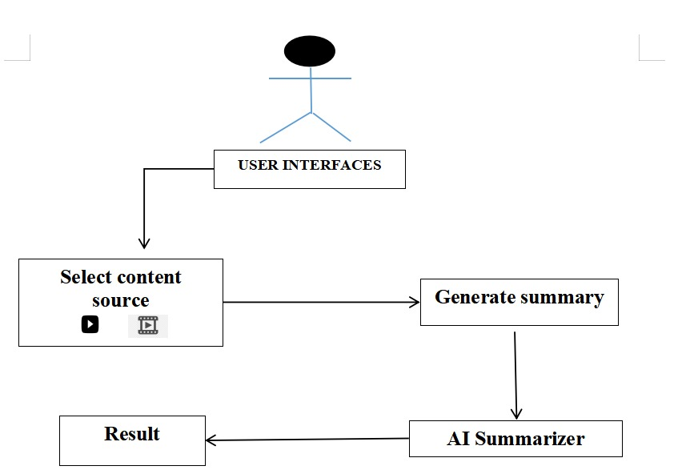
Sample : Architecture

Slide 11

Implementation Modules
YouTube Video Processing
Extracting video ID from YouTube URL
Fetching transcripts using YouTubeTranscriptAPI
Offline Video Processing
Uploading and validating video files
Extracting audio using ffmpeg
Transcribing audio using speech_recognition
Text Summarization
Summarizing YouTube transcripts using Hugging Face Transformers
Summarizing offline transcriptions using Sumy (LSA)
Backend Functionality
Flask-based API for handling requests
Secure file handling and temporary storage

Slide 12

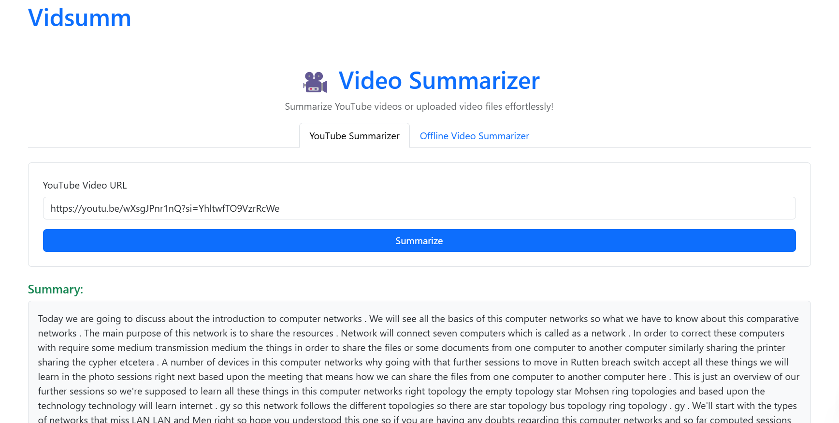
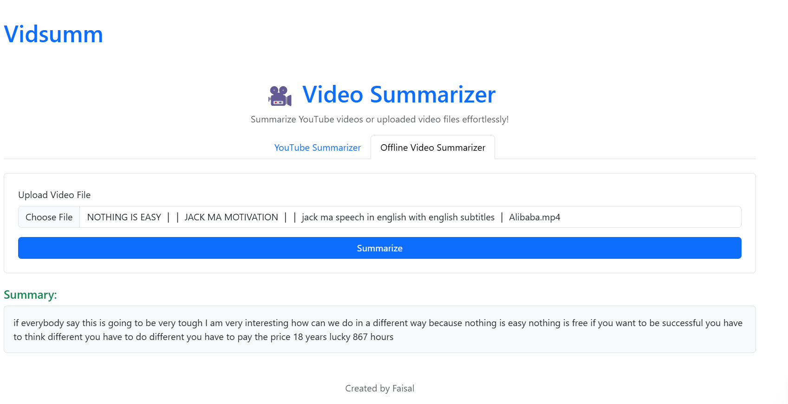
Results – Presentation & Demonstration
Demo Highlights
The YouTube Summarizer tab while summarizing a video.
The Offline Video Summarizer tab with a sample summary.

Slide 13
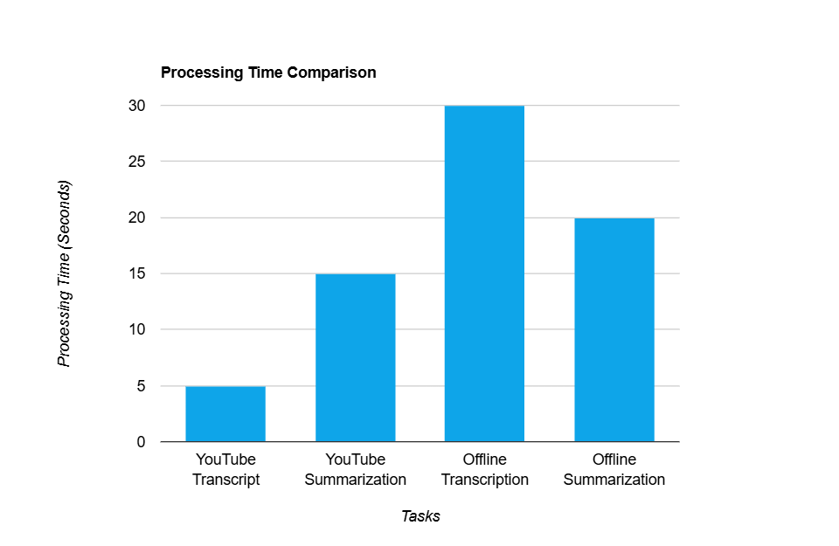
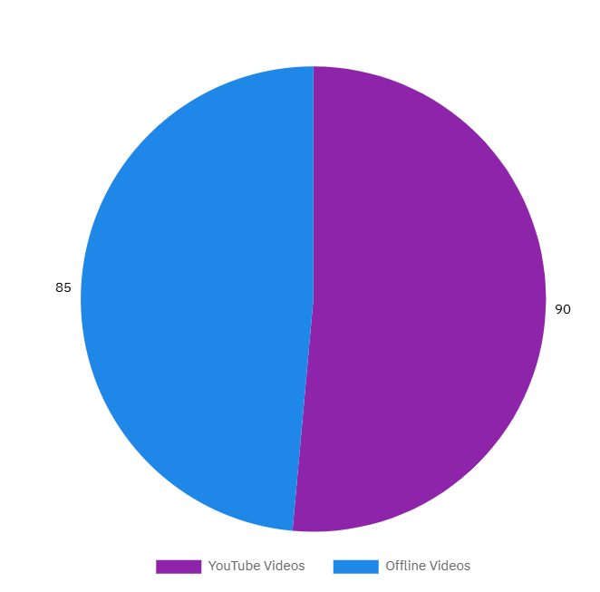
Success Rate of Summarization
Bar chart
Pie chart
Success Rate of Summarization
85%
90%

Slide 14

Conclusions
Successfully automated video summarization using AI.
Improved accessibility for video content through concise summaries.
Future enhancements:
Enhance summarization accuracy by fine-tuning models.
Support additional languages for transcription and summarization.
Scale the system for real-time summarization in live streams.

Slide 15
Bibliography
A. Smith and J. Brown, "Video Content Summarization Using Machine Learning Techniques," IEEE Transactions on Multimedia, vol. 25, no. 6, pp. 1123-1134, June 2023.
P. Johnson and R. Patel, "Audio Summarization Techniques: A Comprehensive Survey," IEEE Transactions on Audio, Speech, and Language Processing, vol. 31, no. 2, pp. 213-229, Feb. 2022.
L. Wang, K. Chen, and M. Lee, "Advances in Text Summarization Algorithms," IEEE Access, vol. 10, pp. 10100-10115, Mar. 2023.
D. Kumar and T. Nguyen, "Unified Multimodal Summarization: Challenges and Opportunities," Proceedings of the IEEE International Conference on Artificial Intelligence, pp. 987-995, Dec. 2022.

Slide 16

Thank You

Slide 17

Q & A

